Slide 1
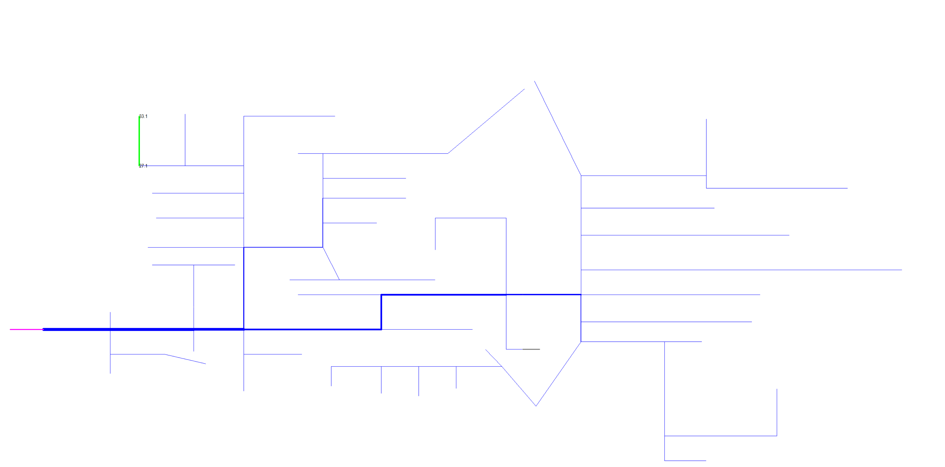
IEEE 123 Bus Feeder
132 buses (278 Phase)
3 nested levels (6 Control areas)

Slide 2
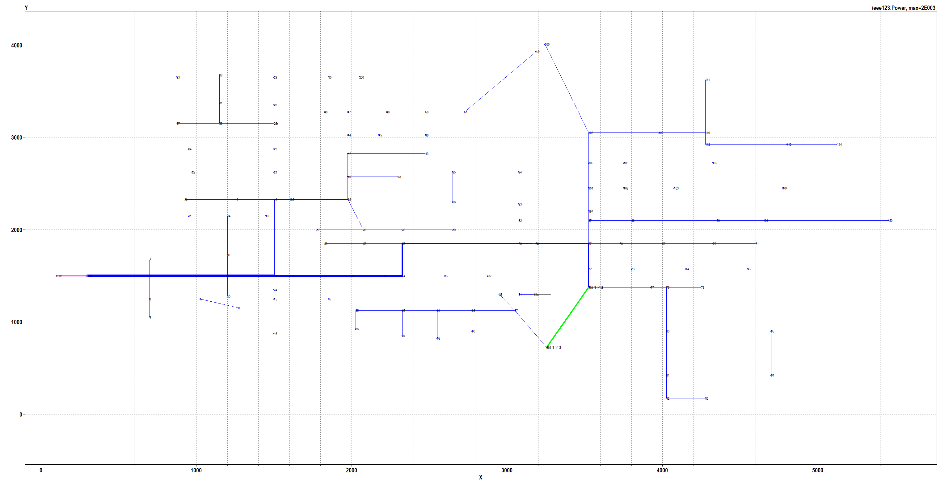
IEEE 123 Bus Feeder
132 buses (278 Phase)
3 nested levels (6 Control areas)

Slide 3
IEEE 123 Bus Feeder
132 buses (278 Phase)
3 nested levels (6 Control areas)
18
18
18
18
18
18
18
18
18
18
18
18
18
18
18
18
18
18
18
18
18
18
18
18
18
18
18
18
18
18
18
18
18
18
18
18
18
18
18
18
18
18
18
20.1
19.1
18
35
135
18
18
11.1
14.1
10.1
18
18
18
18
18
18
18
18
18
18
18
18
18
18
18
18
18
sourcebus
9r.1
18
18
18
18
2.2
9.1
18
18
18
18
149
7
8
13
18
18
18
18
1
152
18
18
18
150r
12.2
34.3
18
18
18
3.3
5.3
15.3
18
18
18
6.3
17.3
18
18
18
18
18
4.3
16.3
18
18
18
18
18
18
18
18
18
18
18

Slide 4
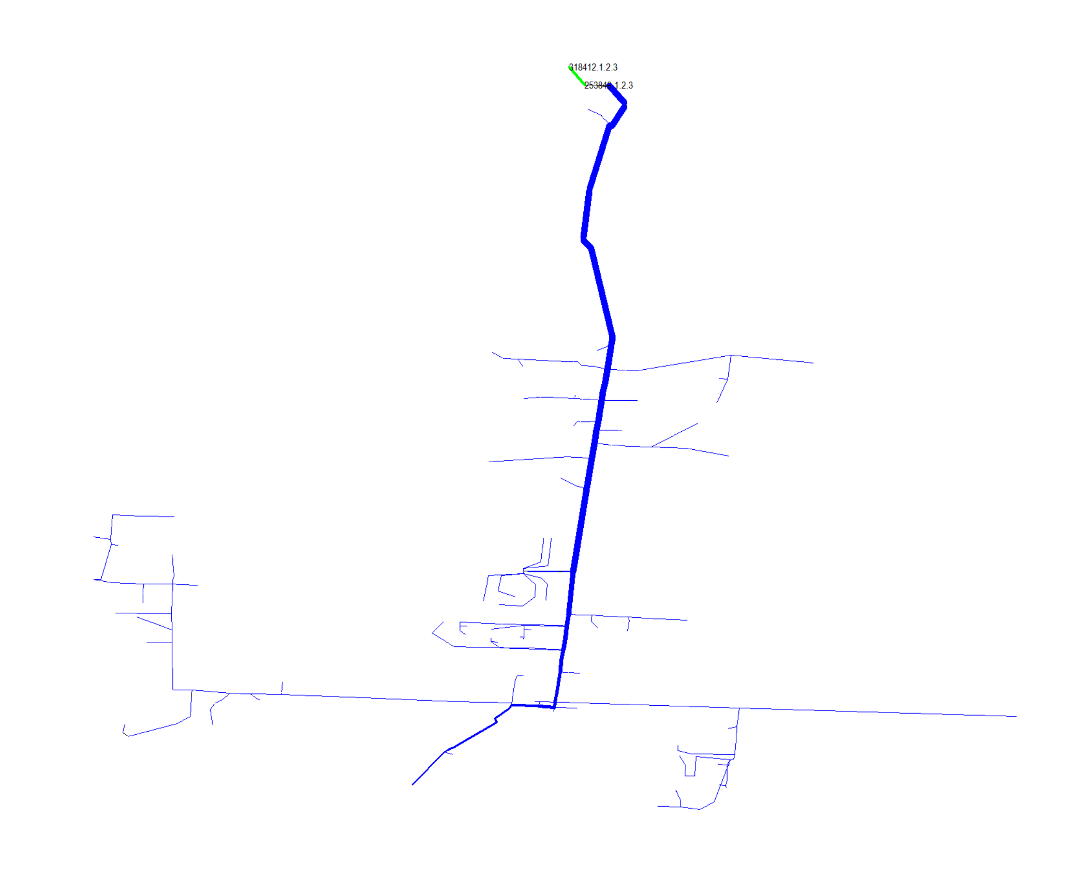
OpenDSS Ckt 7
1255 Buses (2452 Phase) 6 nested levels (9 Control Areas)

